Slide 1
Queues
What is a Queue?
Queue Implementations:
  Queue As Array
  Queue As Circular Array
  Queue As Linked List
Some Applications of Queues
Priority Queues
Some Applications of Priority Queues

Slide 2
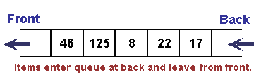
What is a queue?
Queues are linear data structures in which we add elements to one end and remove them from the other end.
The first item to be inserted (en-queued) is the first to be deleted (de-queued). A queue is therefore called a First In First Out (FIFO) data structure.
Queue operations:
  Enqueue: insert an element at the rear of the queue
  Dequeue: delete an element at the front of the queue
  GetHead: get the element at the front without deleting it

Slide 3
What is a queue? (Cont’d)
Rear
Front
 |  |  | 4 | 1 | 3
Given the following Queue, how will it change when we apply the given operations?
enqueue(1);
 |  | 1 | 4 | 1 | 3
enqueue(5);
 | 5 | 1 | 4 | 1 | 3
dequeue();
 | 5 | 1 | 4 | 1
dequeue();
 | 5 | 1 | 4
dequeue();
 | 5 | 1

Slide 4
Queue Implementation
In our implementation, a queue is a container that extends the AbstractContainer class and implements the Queue interface:
We provide three Queue implementations:
  QueueAsArray
  QueueAsCircularArray
  QueueAsLinkedList
public interface Queue extends Container{
public abstract Object getHead();
public abstract void enqueue(Object obj);
public abstract Object dequeue();
}

Slide 5
QueueAsArray
public class QueueAsArray extends AbstractContainer
implements Queue {
protected Object[] array;
protected int rear = 0;
protected int size;
public QueueAsArray(int size) {
array = new Object[size];
this.size = size;
}
public void purge(){
int index = 0;
while(count > 0){
array[index] = null;
index++;
count--;
}
rear = 0;
}
Complexity is O(...)

Slide 6
QueueAsArray (Cont’d)
public Object getHead(){
if(count == 0)
throw new ContainerEmptyException();
else
return array[0];
}
public void enqueue(Object obj){
if(count == size){
throw new ContainerFullException();
}
else{
array[rear++] = obj;
count++;
}
}
Complexity is O(...)
Complexity is O(...)

Slide 7
QueueAsArray (Cont’d)
public Object dequeue(){
if(count == 0)
throw new ContainerEmptyException();
else
{
Object obj = array[0];
count--;
for(int k = 1; k <= count; k++)
array[k - 1] = array[k];
rear--;
return obj;
}
}
Complexity is O(...)

Slide 8
QueueAsArray (Cont’d)
public Iterator iterator() {
return new Iterator() {
int index = 0;
public boolean hasNext(){
return index < count;
}
public Object next(){
if(index == count)
throw new NoSuchElementException();
else {
Object obj = array[index++];
return obj;
}
}
};
}

Slide 9
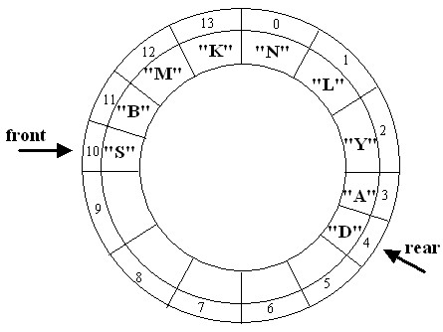
QueueAsCircularArray Implementation
By using modulo arithmetic for computing array indexes, we can have a queue implementation in which each of the operations enqueue, dequeue, and getHead has complexity O(1)
Enqueue(“P”)
will result in …

Slide 10
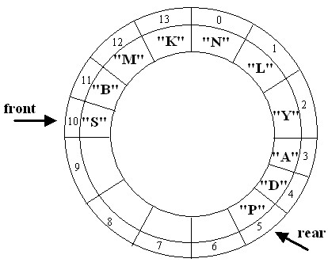
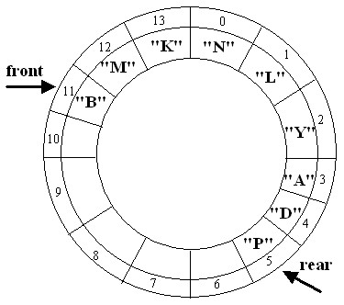
QueueAsCircularArray Implementation (Cont’d)
Dequeue()
will result in

Slide 11
QueueAsCircularArray (Cont’d)
public class QueueAsCircularArray extends AbstractContainer
implements Queue {
protected Object[] array;
protected int front = 0;
protected int rear = 0;
protected int size;
public QueueAsCircularArray(int size) {
array = new Object[size]; this.size = size;
}
public void purge(){
int index = front;
while(count > 0){
array[index] = null;
index = (index + 1) % size;
count--;
}
front = rear = 0;
}
Complexity is O(...)

Slide 12
QueueAsCircularArray (Cont’d)
public Object getHead(){
if(count == 0) throw new ContainerEmptyException();
else return array[front];
}
public void enqueue(Object obj){
if(count == size) throw new ContainerFullException();
else {
array[rear] = obj;
rear = (rear + 1) % size;
count++;
}
}
public Object dequeue(){
if(count == 0)throw new ContainerEmptyException();
else {
Object obj = array[front];
front = (front + 1) % size;
count--;
return obj;
}
}
Complexity is O(...)
Complexity is O(...)
Complexity is O(...)

Slide 13
QueueAsCircularArray (Cont’d)
public Iterator iterator(){
return new Iterator() {
int index = front;
int counter = 0;
public boolean hasNext(){
return counter < count;
}
public Object next(){
if(counter == count)
throw new NoSuchElementException();
else {
Object obj = array[index];
index = (index + 1) % size;
counter++;
return obj;
}
}
};
}

Slide 14
QueueAsLinkedList
public class QueueAsLinkedList extends AbstractContainer
implements Queue {
protected MyLinkedList list;
public QueueAsLinkedList(){list = new MyLinkedList();}
public void purge(){
list.purge();
count = 0;
}
public Object getHead(){
if(count == 0)
throw new ContainerEmptyException();
else
return list.getFirst();
}
Complexity is O(...)
Complexity is O(...)

Slide 15
QueueAsLinkedList (Cont’d)
public void enqueue(Object obj){
list.append(obj);
count++;
}
public Object dequeue(){
if(count == 0)
throw new ContainerEmptyException();
else {
Object obj = list.getFirst();
list.extractFirst();
count--;
return obj;
}
}
Complexity is O(...)
Complexity is O(...)

Slide 16
QueueAsLinkedList (Cont’d)
public Iterator iterator() {
return new Iterator() {
MyLinkedList.Element position = list.getHead();
public boolean hasNext(){
return position != null;
}
public Object next(){
if(position == null)
throw new NoSuchElementException();
else{
Object obj = position.getData();
position = position.getNext();
return obj;
}
}
};
}

Slide 17
Application of Queues
Direct applications
  Waiting lines: Queues are commonly used in systems where waiting line has to be maintained for obtaining access to a resource. For example:
    an operating system may keep a queue of processes that are waiting to run on the CPU.
    Access to shared resources (e.g., printer)
    Simulation of real-world situations, e.g., determine how many tellers to have in order to serve each customer within “reasonable” wait time.
  Multiprogramming
Indirect applications
  Auxiliary data structure for algorithms
  Component of other data structures
    Example: Tree and Graph Breadth-First traversal

Slide 18
Application of Queues: Simulations
Problem Statement: To simulate the flow of customers through a checkout line: (Edited from http://www.cs.uregina.ca/Links/class-info/210/Queue/)
  The objective is to try to reduce the number of tellers in a way that, “most probably”, customers would have to wait a maximum of x minutes before getting served.
  Assume that:
    Every minute, 0, 1, or 2 customers will need to be served in a checkout line.
    The expected service time for a customer is 1 minute.
    There is one checkout line available.
  Find the number of customers not served, so far, after n minutes of service.

Slide 19
Application of Queues: Simulations (Cont’d)
initialize the queue to empty.
for ( minute = 0 ; minute < n ; minute++ ) {
if (the queue is not empty)
remove the customer at the front of the queue;
compute a random number k between 0 and 3;
if (k == 1)
add one customer to the queue;
else if (k == 2)
add two customers to the queue;
} // else if(k == 0) or (k == 3) do not add
// any customer to the queue

Slide 20
Priority Queues
In a normal queue, the enqueue operation adds an item at the end of the queue, and the dequeue operation removes an item from the front of the queue.
A priority queue is a queue in which the dequeue operation removes an item from the front of the queue; but the enqueue operation inserts items according to their priorities.
A higher priority item is always enqueued before a lower priority element.
An element that has the same priority as one or more elements in the queue is enqueued after all the elements with that priority.

Slide 21
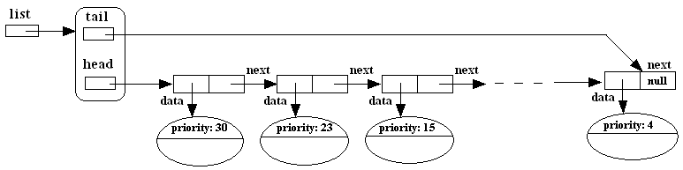
Priority Queue Implementation
One implementation of Priority Queue uses a singly-linked list that has a tail reference:
In a later lesson we will study another implementation of priority queue that uses a data structure called the binary-heap

Slide 22
Priority Queues: Some Applications
A Priority Queue can be used in any application that uses a set of elements of various priorities where the element of highest priority need be accessed first.
Huffman Codes
Huffman Codes are used to compress a block of data into a smaller space.
The algorithm starts by collecting the frequencies of all the characters in the data block and then processes each one in order of descending frequency - a perfect place to use a Priority Queue.
Dijkstra's Algorithm for All Shortest Paths
This graph algorithm always selects the next connected edge of lowest path cost from the starting node. These edges can be stored and retrieved in a Priority Queue.
Prim's Algorithm
Prim's is another graph algorithm which can utilize a Priority Queue. It works by always selecting the next connected edge of lowest path cost.
CPU Scheduling
A CPU can only run one process at a time, but there may be many jobs of various priorities waiting to be run.
A Priority Queue can be used to quickly select the next process to run based upon its priority.

